Slide 1
Bubble Sort in C#
Presentation prepared by
Vihar Dasari ( VD ) - NB HealthTech

Slide 2
Topics
INDEX
What is Bubble Sort ?
How It Works ?
Code
Output

Slide 3
What is Bubble Sort ?
Bubble Sort is a simple sorting algorithm.
It is a comparison based algorithm where each pair of adjacent elements in the array are compared and swapped if they are not in order.
It’s called “Bubble Sort” because the largest element is “BUBBLED UP”

Slide 4
Lets see, How It Works !...........(with an example)
5 | 9 | 1 | 4 | 7
5 | 1 | 4 | 7 | 9
No swapping
( since 9 > 5)
5 | 1 | 9 | 4 | 7
1 | 5 | 4 | 7 | 9
swap
( since 9 > 1)
swap
( since 5 > 1)
1st Iteration
2nd Iteration
5 | 1 | 4 | 9 | 7
1 | 4 | 5 | 7 | 9
swap
( since 9 >4)
swap
( since 5 > 4)
5 | 1 | 4 | 7 | 9
1 | 4 | 5 | 7 | 9
swap
( since 9 > 7)
Sorted Array

Slide 5
C# Code
using System;
namespace BubbleSort
{
class MySort
{
static void Main(string[] args)
{
int[] arr = { 78, 55, 45, 98, 13 };
int temp;
Console.WriteLine("UnSorted:");
foreach (int p in arr)
Console.Write(p + " ");
Console.WriteLine("\n");
for (int j = 0; j <= arr.Length - 2; j++)
{
for (int i = 0; i <= arr.Length - 2; i++)
{
if (arr[i] > arr[i + 1])
{
temp= arr[i + 1];
arr[i + 1] = arr[i];
arr[i] = temp;
}
}
}
Console.WriteLine("Sorted:");
foreach (int p in arr)
Console.Write(p + " ");
Console.Read();
}
}
}
Basic initializing
Logic
Displaying sorted array

Slide 6
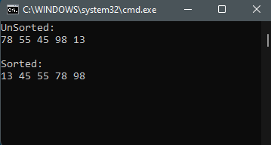
Output

Slide 7
FIN.

